Slide 1
Unit 3.2 Structuring System Process Requirements
Introduction; Process Modeling (Modeling a System’s Process for Structured Analysis, Deliverables and Outcomes); Data Flow Diagrams (Context Diagram and DFD, Data Flow Diagramming Rules, Decomposition and Balancing DFDs); Modeling Logic with Decision Tables, Decision Trees, and Pseudocodes

Slide 2
System Process Requirements
In this topic, our focus will be on one tool that is used to coherently represent the information gathered as part of requirements determination—data flow diagrams. Data flow diagrams enable you to model how data flow through an information system, the relationships among the data flows, and how data come to be stored at specific locations. Data flow diagrams also show the processes that change or transform data. Because data flow diagrams concentrate on the movement of data between processes, these diagrams are called process models.
Decision tables allow you to represent the conditional logic that is part of some data flow diagram processes.

Slide 3
Process Modeling
Process modeling involves graphically representing the functions, or processes, that capture, manipulate, store, and distribute data between a system and its environment and between components within a system.
A common form of a process model is a data flow diagram (DFD). DFDs, the traditional process modeling technique of structured analysis and design and one of the techniques most frequently used today for process modeling.
Modeling a system’s Process for structured Analysis: The analysis team enters the requirements structuring phase with an abundance of information gathered during the requirements determination phase. During requirements structuring, you and the other team members must organize the information into a meaningful representation of the information system that currently exists and of the requirements desired in a replacement system.

Slide 4
Deliverables and Outcomes
In structured analysis, the primary deliverables from process modeling are a set of coherent, interrelated DFDs. First, a context diagram shows the scope of the system, indicating which elements are inside and which are outside the system. Second, DFDs of the system specify which processes move and transform data, accepting inputs and producing outputs. These diagrams are developed with sufficient detail to understand the current system and to eventually determine how to convert the current system into its replacement. Finally, entries for all of the objects included in all of the diagrams are included in the project dictionary or CASE repository.

Slide 5
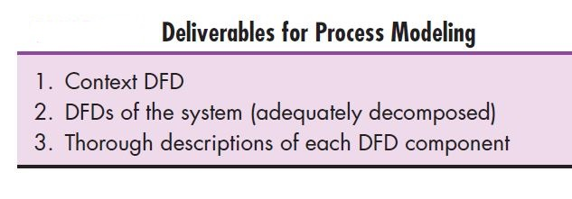

Slide 6
Data Flow Diagramming Mechanics
DFDs are versatile diagramming tools. With only four symbols, you can use DFDs to represent both physical and logical information systems. DFDs are not as good as flowcharts for depicting (to represent or show something in a picture or story ) the details of physical systems.
There are two different standard sets of DFD symbols; each set consists of four symbols that represent the same things: data flows, data stores, processes, and sources/sinks (or external entities).

Slide 7
Data Flow Diagramming Mechanics
A data store is data at rest. A data store may represent one of many different physical locations for data; for example, a file folder, one or more computer-based file(s), or a notebook. A data store might contain data about customers, students, customer orders, or supplier invoices.
A process is the work or actions performed on data so that they are transformed, stored, or distributed. When modeling the data processing of a system, it does not matter whether a process is performed manually or by a computer.

Slide 8
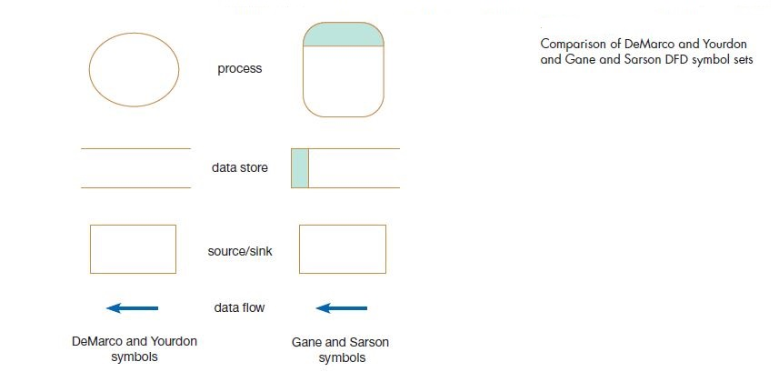

Slide 9
Finally, a source/sink is the origin and/or destination of the data. Sources/sinks are sometimes referred to as external entities because they are outside the system. Once processed, data or information leave the system and go to some other place. Sources and sinks are outside the system we are studying.
There are two type of DFD conventions. In both conventions, a data flow is represented as an arrow. The arrow is labeled with a meaningful name for the data in motion; for example, Customer Order, Sales Receipt, or Paycheck. The name represents the aggregation of all the individual elements of data moving as part of one packet, that is, all the data moving together at the same time.
Sources/Sinks are always outside the information system and define the boundaries of the system. Data must originate outside a system from one or more sources, and the system must produce information to one or more sinks (these are principles of open systems, and almost every information system is an open system). If any data processing takes place inside the source/sink, it is of no interest because this processing takes place outside the system we are diagramming.

Slide 10
Developing DFD
Capturing data from different sources
Maintaining data stores
Producing and distributing data to different sinks
High-level descriptions of data transformation operations

Slide 11
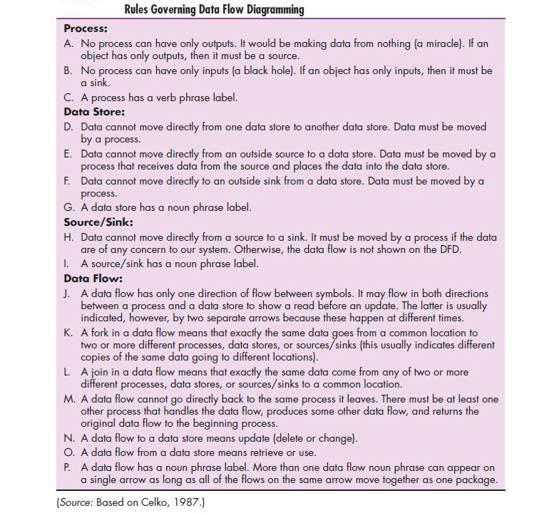

Slide 12
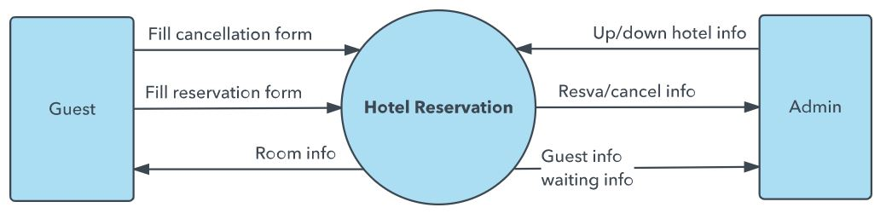
DFD Level 0 is also called a Context Diagram. It’s a basic overview of the whole system or process being analyzed or modeled. It’s designed to be an at-a-glance view, showing the system as a single high-level process, with its relationship to external entities. It should be easily understood by a wide audience, including stakeholders, business analysts, data analysts and developers.

Slide 13
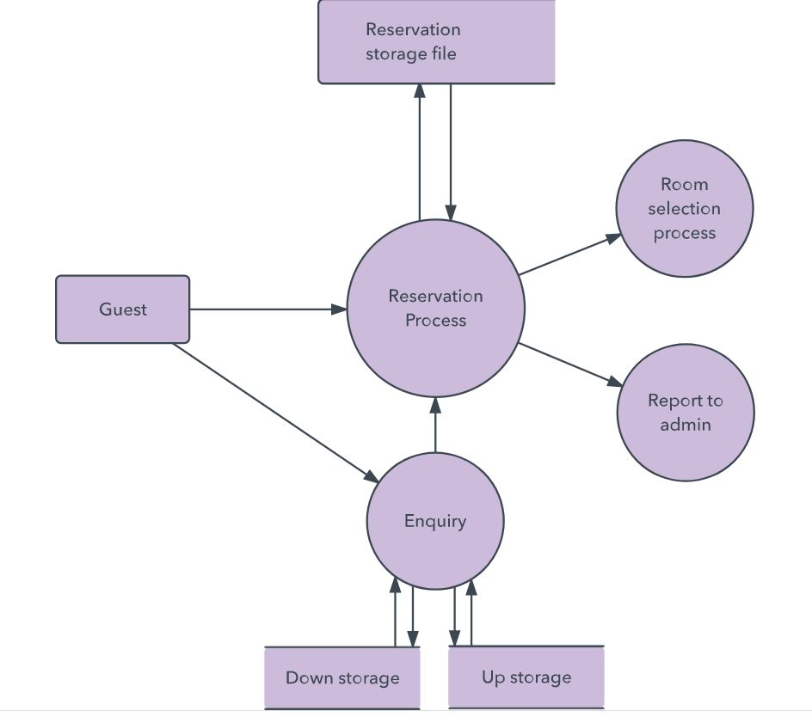
DFD Level 1 provides a more detailed breakout of pieces of the Context Level Diagram. You will highlight the main functions carried out by the system, as you break down the high-level process of the Context Diagram into its subprocesses.

Slide 14
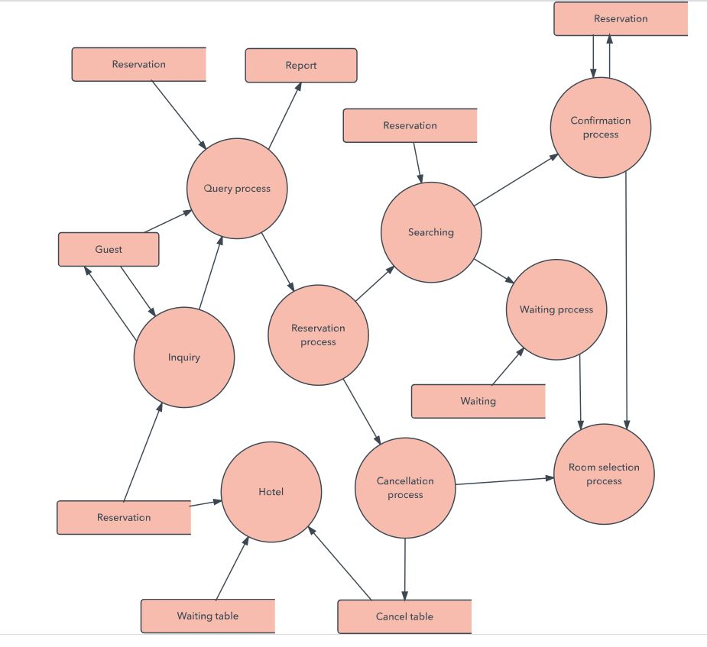
DFD Level 2 then goes one step deeper into parts of Level 1. It may require more text to reach the necessary level of detail about the system’s functioning.

Slide 15
Decomposition of DFDs
Upon thinking more about the system, the larger system consisted of four processes. The act of going from a single system to four component processes is called (functional) decomposition. Functional decomposition is an iterative process of breaking the description or perspective of a system down into finer and finer detail. This process creates a set of hierarchically related charts in which one process on a given chart is explained in greater detail on another chart. Each resulting process (or subsystem) is also a candidate for decomposition. Each process may consist of several sub processes. Each sub process may also be broken down into smaller units. Decomposition continues until you have reached the point at which no sub process can logically be broken down any further. The lowest level of a DFD is called a primitive DFD.

Slide 16
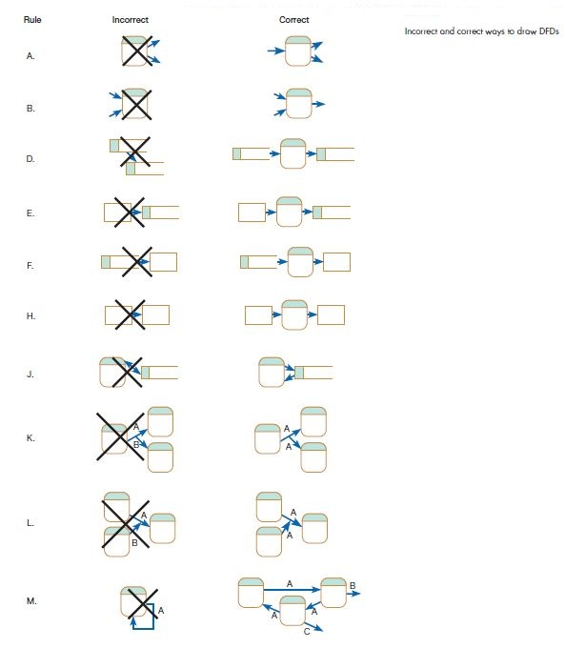

Slide 17
Balancing DFDs
When you decompose a DFD from one level to the next, there is a conservation principle at work. You must conserve inputs and outputs to a process at the next level of decomposition. In other words, Process 1.0, which appears in a level-0 diagram, must have the same inputs and outputs when decomposed into a level-1 diagram. This conservation of inputs and outputs is called balancing.

Slide 18
Using Data flow Diagramming in the Analysis Process
Learning the mechanics of drawing DFDs is important because DFDs have proven to be essential tools for the structured analysis process. Beyond the issue of drawing mechanically correct DFDs, there are other issues related to process modeling with which an analyst must be concerned.
Such issues, including whether the DFDs are complete and consistent across all levels, which covers guidelines for drawing DFDs.
Another issue to consider is how you can use DFDs as a useful tool for analysis.

Slide 19
Guidelines for drawing DFDs
Completeness : The concept of DFD completeness refers to whether you have included in your DFDs all of the components necessary for the system you are modeling. If your DFD contains data flows that do not lead anywhere or data stores, processes, or external entities that are not connected to anything else, your DFD is not complete.
Consistency : The concept of DFD consistency refers to whether or not the depiction of the system shown at one level of a nested set of DFDs is compatible with the depictions of the system shown at other levels. A gross violation of consistency would be a level-1 diagram with no level-0 diagram. Another example of inconsistency would be a data flow that appears on a higher-level DFD but not on lower levels (also a violation of balancing).
Timing: You may have noticed in some of the DFD examples we have presented that DFDs do not do a very good job of representing time. On a given DFD, there is no indication of whether a data flow occurs constantly in real time, once per week, or once per year. There is also no indication of when a system would run.

Slide 20
Guidelines for drawing DFDs
Iterative Development: The first DFD you draw will rarely capture perfectly the system you are modeling. You should count on drawing the same diagram over and over again, in an iterative fashion. With each attempt, you will come closer to a good approximation of the system or aspect of the system you are modeling. One rule of thumb is that it should take you about three revisions for each DFD you draw.
Primitive DFDs : One of the more difficult decisions you need to make when drawing DFDs is when to stop decomposing processes. One rule is to stop drawing when you have reached the lowest logical level; however, it is not always easy to know what the lowest logical level is.

Slide 21
Modeling logic with decision Tables
A decision table is a diagram of process logic where the logic is reasonably complicated. All of the possible choices and the conditions the choices depend on are represented in tabular form, as illustrated in the decision table in Figure 7-18. The decision table in Figure 7-18 models the logic of a generic payroll system.
The table has three parts: the condition stubs, the action stubs, and the rules. The condition stubs contain the various conditions that apply to the situation the table is modeling. In Figure 7-18, there are two condition stubs for employee type and hours worked. Employee type has two values: “S,” which stands for salaried, and “H,” which stands for hourly. Hours worked has three values: less than 40, exactly 40, and more than 40. The action stubs contain all the possible courses of action that result from combining values of the condition stubs. There are four possible courses of action in this table: Pay Base Salary, Calculate Hourly Wage, Calculate Overtime, and Produce Absence Report. You can see that not all actions are triggered by all combinations of conditions. Instead, specific combinations trigger specific actions. The part of the table that links conditions to actions is the section that contains the rules.

Slide 22
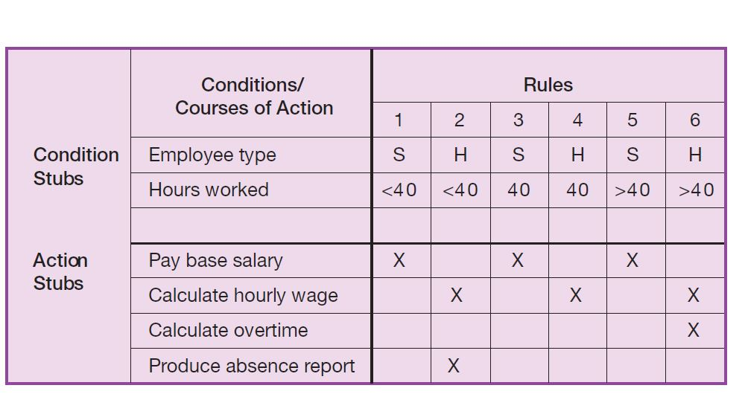
Figure 7-18 Complete decision table for payroll system example

Slide 23
To read the rules, start by reading the values of the conditions as specified in the first column: Employee type is “S,” or salaried, and hours worked is less than 40. When both of these conditions occur, the payroll system is to pay the base salary.
In the next column, the values are “H” and “<40,” meaning an hourly worker who worked less than 40 hours. In such a situation, the payroll system calculates the hourly wage and makes an entry in the Absence Report. Rule 3 addresses the situation when a salaried employee works exactly 40 hours. The system pays the base salary, as was the case for rule 1. For an hourly worker who has worked exactly 40 hours, rule 4 calculates the hourly wage. Rule 5 pays the base salary for salaried employees who work more than 40 hours. Rule 5 has the same action as rules 1 and 3 and governs behavior with regard to salaried employees. The number of hours worked does not affect the outcome for rules 1, 3, or 5. For these rules, hours worked is an indifferent condition in that its value does not affect the action taken. Rule 6 calculates hourly pay and overtime for an hourly worker who has worked more than 40 hours.

Slide 24
Decision Tree
A decision tree is a graph that always uses a branching method in order to demonstrate all the possible outcomes of any decision. Decision Trees are graphical and show a better representation of decision outcomes.
A decision tree is a visual way to represent the same information that appears in a decision table. The Figure shows a decision tree that represents logic for the chemical tracking system.

Slide 25
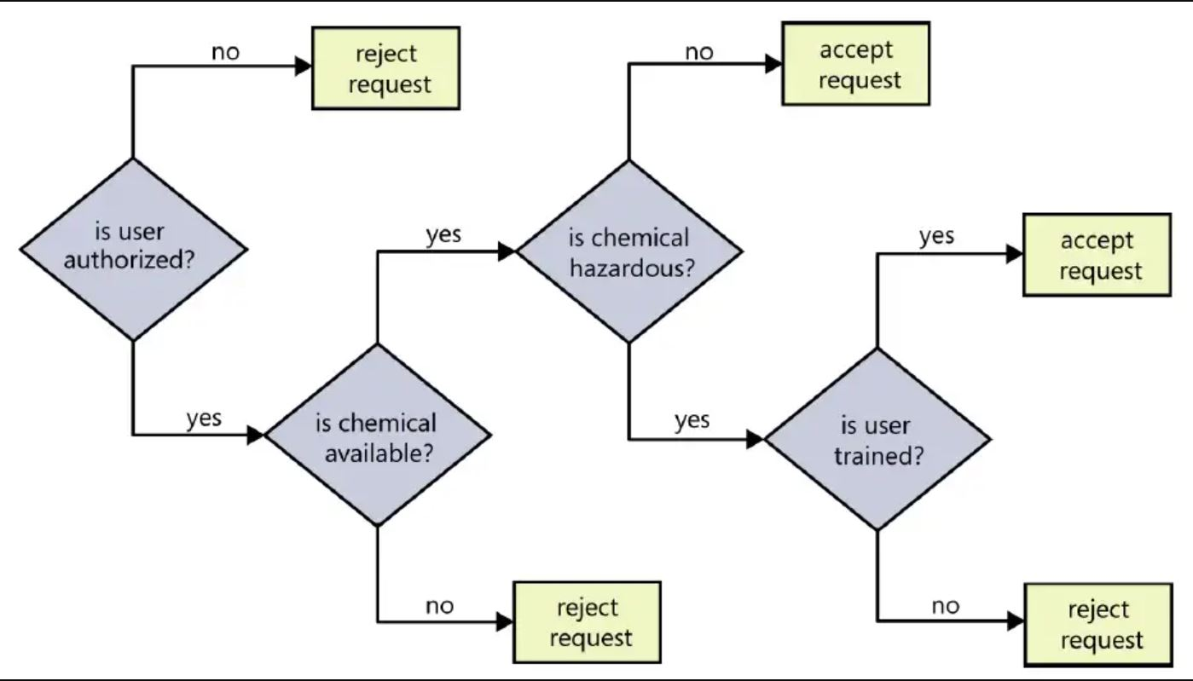
Sample decision tree for the chemical tracking system.

